Slide 1
Generative AI and Language Understanding: Part 5
Sandiway Fong
University of Arizona

Slide 2
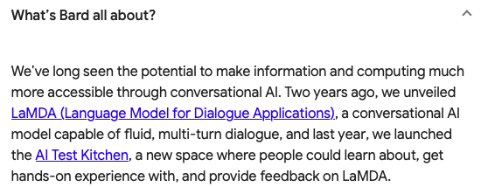
This is the era of Generative AI
https://bard.google.com
https://chat.openai.com/chat

Slide 3
Relative Clauses and Embedding
English is very productive when it comes to relativization. We can relativize any argument of the verb, and adjuncts too.
Examples:
the man left the room at 6pm (Basic sentence)
the man who ◻︎ left the room at 6pm (subject)
the room the man left ◻︎ at 6pm (object)
the time the man left the room at ◻︎ (adjunct)
Can also recursively apply relativization
but center embedding is hard for humans to interpret (perhaps due to performance limitations)

Slide 4
Relative Clauses and Embedding
object vs. subject relativization

Slide 5
Google Bard

Slide 6
ChatGPT

Slide 7
Google Bard
All messed up about grammar! What does Google NL think of the sentence? See next slide
Perhaps it could ask Google NL to help out?

Slide 8
Google Natural Language
nsubj: nominal subject relation
dobj: direct object relation
rcmod: relative clause modifier relation
correctly analyses the relations:
ate(man, sandwich) saw(cat, man) chased(dog, chat)

Slide 9
Google Bard
Recall, Google NL correctly analyses the relations:
ate(man, sandwich) saw(cat, man) chased(dog, chat)

Slide 10
Google Bard
Recall, Google NL correctly analyses the relations:
ate(man, sandwich) saw(cat, man) chased(dog, chat)

Slide 11
ChatGPT

Slide 12
ChatGPT

Slide 13
Berkeley Neural Parser
Analysis from a well-known constituent parser

Slide 14
ChatGPT
Let's make the sentence a little easier to parse

Slide 15
ChatGPT

Slide 16
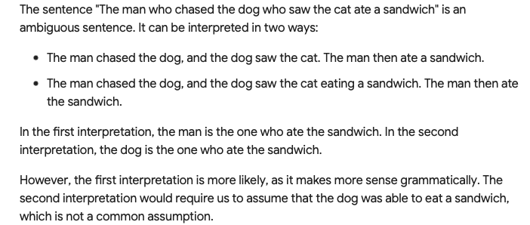
Google Bard

Slide 17
Google Bard

Slide 18
Google Bard

