Slide 1
Generative AI and Language Understanding: Part 1
Sandiway Fong
University of Arizona

Slide 2
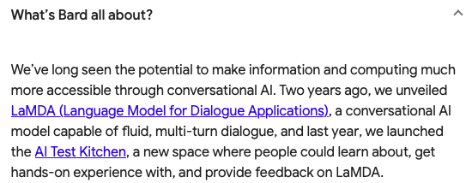
This is the era of Generative AI
https://bard.google.com
https://chat.openai.com/chat

Slide 3
Part 1
ChatGPT and
Structural Ambiguity
Structural Hierarchy
Control Verbs
Updated: Google Bard responses have been added.

Slide 4
Some Caveats and Hints
It sometimes gives a different answer when the question is repeated.
A response doesn't necessarily need a question.
Your chat history can affect the response.
If you vary the question a bit, it may choose a different response.
Asking the right question is key … e.g.
an unrevealing question for this example

Slide 5
Google Bard

Slide 6
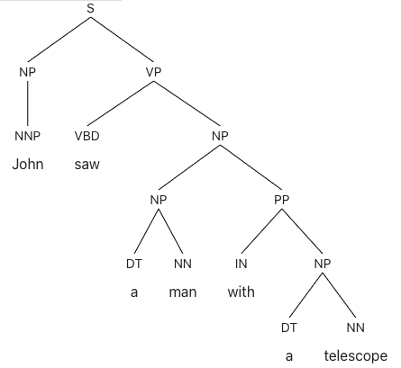
ChatGPT and Structural Ambiguity
#1
#2
But did it explicitly compute this?
Very unlikely

Slide 7
Google Bard

Slide 8
ChatGPT and Structural Ambiguity
#1
#2

Slide 9
Google Bard

Slide 10
Google Bard

Slide 11
ChatGPT and Structural Ambiguity

Slide 12
Google Bard

Slide 13
ChatGPT and Structural Ambiguity

Slide 14
Google Bard

Slide 15
ChatGPT and Structural Ambiguity

Slide 16
Google Bard

Slide 17
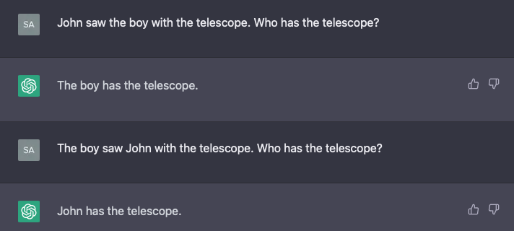
ChatGPT and Structural Ambiguity
proper noun vs. common noun:
seems to affect PP modification (originally noted by a student)

Slide 18
Google Bard

Slide 19
Google Bard

Slide 20
ChatGPT and Structural Ambiguity
Generally, PP attachment not easy for Deep Learning (DL)-based parsers.
Example:
Berkeley Neural Parser
https://parser.kitaev.io

Slide 21
ChatGPT and Structural Ambiguity
the chicken is ready to eat
the chicken_{i} is ready PRO_{i} to eat
the chicken is ready PRO_{arb} to eat the chicken

Slide 22
Google Bard

Slide 23
ChatGPT and Structural Ambiguity

Slide 24
Google Bard

Slide 25
ChatGPT and Structural Ambiguity
A different way to elicit a response

Slide 26
Google Bard

Slide 27
Google Bard

Slide 28
ChatGPT and Structural Ambiguity
the pizza is ready to eat
the pizza_{i} is ready PRO_{i} to eat
the pizza is ready PRO_{arb} to eat the pizza

Slide 29
Google Bard

Slide 30
ChatGPT and Structural Hierarchy
Chomsky (various recent lectures):
Can eagles that fly swim? (English has a rule of auxiliary inversion)
cf. Eagles that fly can swim. / Eagles that can fly swim.
two verbs here: fly is closer to can than swim, but question is about swimming not flying
*Are eagles that flying swim?

Slide 31
ChatGPT and Structural Hierarchy
Chomsky (various recent lectures):
Can eagles that fly swim?
*Are eagles that flying swim?

Slide 32
Google Bard

Slide 33
ChatGPT and Control Verbs
Choice:
X promised Y [PRO to do something]
X ordered Y [PRO to do something]
what knowledge do we have?
promise is a subject control verb (PRO = X)
order is an object control verb (PRO = Y)

Slide 34
ChatGPT and Control Verbs
Example (object control verb):
The caterpillar asked Alice [PRO to go away]. (Reuland 2011: 45)

Slide 35
Google Bard

Slide 36
ChatGPT and Control Verbs
Example (subject control verb):
The caterpillar promised Alice [PRO to go away].

Slide 37
Google Bard

Slide 38
ChatGPT and Control Verbs
Example (object control verb):
The caterpillar ordered Alice [PRO to go away].

Slide 39
Google Bard

Slide 40
ChatGPT and Control Verbs
Example (object control verb):
The caterpillar ordered Alice [PRO to go away].
Doesn't work in this case!
Asking the right question is key

Slide 41
Google Bard

