Slide 1
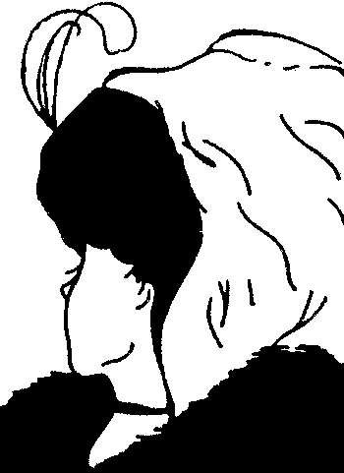
What it’s Like to Be Ancient
Is Perception “Top Down” or rather “Bottom Up?
The picture is ambiguous
Is perception merely the bottom up reception of pure information?
Or is it really top down interpretation or inference based on our background beliefs and attitudes?

Slide 2
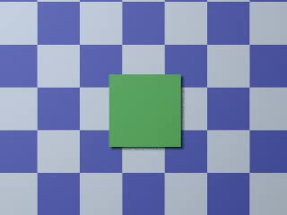
Or Is Perception Bottom Up?
The square is stationary! http://3t.kyb.tuebingen.mpg.de/bu/demo/green-square/index.html
The light source (and shadow) moves
Do we initially see the square as moving because we believe that the light source is stationary and infer that the square must be moving?
Does the persistence of the illusion show that perception is independent of what we know?

Slide 3
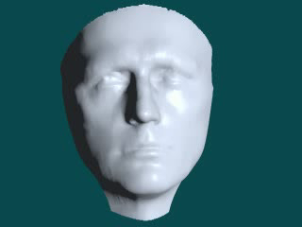
The Mask
We know that the nose in the mask does not change http://3t.kyb.tuebingen.mpg.de/bu/demo/mask/index.html
Nevertheless, we see it as changing
Does this show that perception is not influenced by knowledge?

Slide 4
Change Blindness
See the work of Daniel Simons at
http://www.simonslab.com/
Especially http://viscog.beckman.uiuc.edu/grafs/demos/15.html
http://viscog.beckman.uiuc.edu/flashmovie/12.php

Slide 5
What’s the Moral of the Story?
If perception is top down, then how the ancients saw their world may have differed from the way we see our world
Perception and Knowledge can conflict (The mask and the square)
When should we trust perception?

Slide 6
Early Ancient Greek Philosophers and Questions 2000 Years Before Science
Is the physical universe orderly or random?
Some change appears regular; some does not. Why?
Is the universe determined by capricious gods or something fixed, constant and knowable?

Slide 7
Ancient Philosophy and the Quest for Knowledge
Ancient Greece (map)
Presocratics = Ancient Greek Philosophers (600-470 bc) who lived before the time of Socrates (470-399 bc)
Some Presocratics accept the reality of observable and orderly change; others deny it
Some Presocratics are skeptical regarding perception.
A skeptic denies that genuine knowledge (of a specified type) is possible

Slide 8
Presocratics Who Affirm the Reality and Intelligibility of Change
Thales (600 BC) & Reductionism
Things aren’t what they appear to be
Contrary to appearance, everything is really water!

Slide 9
Thales
Since everything is water, all change is regular, predictable and determined by the internal nature of water
We can understand everything just by understanding what water really is
Explanation by reduction to the unobservable
Many things do not appear to be water
Nevertheless, they really are water
So, things are not as they appear in perception
Hence, the problem of skepticism with respect to perception arises

Slide 10
Pythagoras (560 BC)
Everything is number (even music!)
Pythagorean formula shows how abstract thought (as opposed to perception) can reveal the true nature of things
Abstracta (numbers) are real!
Understand change and reality through mathematics, not perception

Slide 11
Pythagorean Theorem
Proof of the Pythagorean Theorem by congruence

Slide 12
Algebraic Proof of Pythagorean Theorem
Consider a square X whose sides c equal the hypotenuse of right triangle abc.
Embed X in a larger square Y whose sides = a+b such that the corners of X each meet a side of Y.
Then:
(a+b)x(a+b) = c² + 4((axb)/2)
(a+b)x(a+b) - 4((axb)/2) = c²
a²+ab+b²+ab - 2(ab) = c²
a²+b² = c²

Slide 13
Pythagorean Theorem and Two Types of Knowledge
“A Priori” Knowledge (Latin: “from the former”)
Evidentially based on logically pure reason rather than on perception
Perception cannot disconfirm what is known a priori
Reasoning involving only definitions, axioms and abstract/logical/mathematical proof
Eg: The Pythagorean Theorem
Transcendent Knowledge of what is both Universal and Necessary rather than perceptual knowledge of the individual and particular
“A Posteriori” Knowledge (Latin: “from the latter”)
Evidentially based on perception
Also called “Empirical” Knowledge

Slide 14
Irrational Numbers
The Pythagoreans discovered that some numbers are irrational
Irrational numbers cannot be expressed as ratios of integers (non-terminating non-repeating decimals)
E.g.
The square root of 2 = 1.4142…
Π = 3.1459265…
The mathematical constant whose value is the ratio of any circle's circumference to its diameter in the Euclidean plane; this is the same value as the ratio of a circle's area to the square of its radius. It is approximately equal to 3.14159265 in the usual decimal notation
Puzzle: If we can’t represent a number
can we even “think of it”
Can we be sure that we are thinking of it rather than some other number?

Slide 15
Heraclitus (540 BC)
Perpetual Flux: “you can’t step into the same river twice”
All things are always changing
How can we have “fixed unchanging knowledge” of what is always changing
Consider: how can a fixed picture/idea accurately represent what is in perpetual flux?
Logos = Abstract, Unchanging Law that ensures the necessity and constancy of the pattern of change
Logos is knowable only through the process of abstract thought
Logos is objectively real

Slide 16
Atomists: Democritus (460 BC)
Posits
Atoms
the Void (space)
Swerve
All atoms are
Unobserved
physically the same
internally undifferentiated or simple
Explanation of change by reductive appeal to
number, position, and motion of atoms
mathematics

Slide 17
Compare:
Classical Determinism: Pierre-Simon Laplace (1749-1827; French mathematician, astronomer, physicist)
“We ought then to regard the present state of the universe as the effect of its previous state and as the cause of the one which is to follow. Given for one instant a mind which could comprehend all the forces by which nature is animated and the respective situation of the beings that compose it—a mind sufficiently vast to subject these data to analysis—it would embrace in the same formula the movements of the greatest bodies of the universe and those of the lightest atom; for it, nothing would be uncertain and the future, as the past, would be present to its eyes. (Laplace 1796)”
Contemporary Quantum Indeterminacy: Niels Bohr, Werner Heisenberg, Erwin Schrödinger (1926): The state of a physical system is merely probabilistic (until measured) and thus not completely determined by its history.
The position and momentum of a particle cannot be known simultaneously.

Slide 18
Presocratics Who Deny Reality of Change, Motion, Plurality and Reject Perception
Doubting motion and plurality
Magicians and illusionists entertain us by presenting illusions that impress us as “convincing” although we know to be misleading
Familiar illusions of apparent motion show that what seems to move might actually be at rest
Viewed through a prism, a single object can appear to be many

Slide 19
Parmenides (500 BC)
Monism of Parmenides
Only one thing - the One – exists
Pluralism is false!
the One is itself internally simple and lacks any form of differentiation
the One is ineffable & incomprehensible
the One is immutable
Change is impossible!

Slide 20
An Argument for Monism
If change were possible, then something (e.g. a butterfly) could come from nothing
E.g. x finally becomes a butterfly only if x originally is not-a-butterfly
Not-being-a-butterfly = being nothing = nothing
But it is impossible that something come from nothing
I.e., it is impossible that a butterfly come from nothing
So, change is impossible; it is only illusory

Slide 21
Argument against plurality
Plurality = the existence of many different things, eg. X and Y
Of course, most people believe in plurality, but this is a mistake for the following reason:
If X is not Y, then X = the absence of Y
But the absence of Y = nothing
Hence, if X is not Y, then X = nothing!
If X = nothing, then X does not exist, which contradicts plurality!
So, the very idea of plurality is contradictory and, hence, impossible!
Thus, Monism must be true!

Slide 22
Zeno (Parmenides’ Student)
All change is motion; but motion is impossible as shown by the following example that generalizes to all supposed cases of motion:

Slide 23
Achilles and the Tortoise
Consider a straight race course on which Achilles and the Tortoise compete
Achilles allows the Tortoise to start at the halfway point
In order for Achilles to defeat the Tortoise, Achilles must first reach the halfway point.
It will take Achilles some time to reach the halfway point
In that period of time, the Tortoise will have advanced to a more distant point.

Slide 24
When Achilles reaches that more distant point, the Tortoise will have again advanced beyond that point
This holds for every point on the tract that the Tortoise ever might occupy.
Hence the Tortoise must always be ahead of Achilles & Achilles cannot win the race
The appearance of Achilles’ victory over the Tortoise can only be an illusion.
This generalizes to all apparent instances of motion
So, all motion is illusory and unreal!

Slide 25
Zeno’s Intended Moral
Abstract a priori reasoning always trumps perception and empirical / a posteriori reasoning
This is the lesson of the Pythagorean theorem
We reject measurement or perception as faulty when it conflicts with the abstract reasoning that establishes the Pythagorean Theorem
Since we go this far with the Pythagorean theorem, should we also accept Zeno’s paradox and reject motion as illusory and skeptically repudiate perception?

Slide 26
Summary of Parmenides and Zeno
Monism is true; motion and plurality are impossible and illusory
Favor Abstract Reasoning over Perception
Distinguish knowledge from mere (false) opinion

Slide 27
Knowledge requires a certain unchanging representation that corresponds to what is represented
Knowledge is like a photograph
What changes cannot be so represented
A photograph, which is fixed, cannot accurately depict what is in flux
So, knowledge of change is impossible
What is real can be known, so change can’t be real

